Slide 1

Random Password Generator Using Python & GUI
Presenter : Ayush Singh
B-TECH (IT)
KIET GROUP OF INSTITUTIONS
DELHI-NCR

Slide 2
Student Portfolio
Name : Ayush Singh
Course : B-Tech
Year : 2 nd Branch : IT
University Roll no. 2000290130052
Internship : Minor Specialisation in Machine
Learning
Internship Supervisor : Ms . Surbhi Vij

Slide 3

Overview
Introduction of the project
Technical aspects of the project(back end)
Output of the project (front end)
Future Scope of the Project
Conclusion

Slide 4
Introduction
The Project name is Random Password Generator using GUI in python .
This Project is based on Python and in that by the use of GUI (Graphic User Interface ) and Tkinter Module it has been enhanced .
In this Project we just have to provide Password Length and it will give us an Random and Strong password using upper case letters,lower case letters ,numerics and symbols .

Slide 5
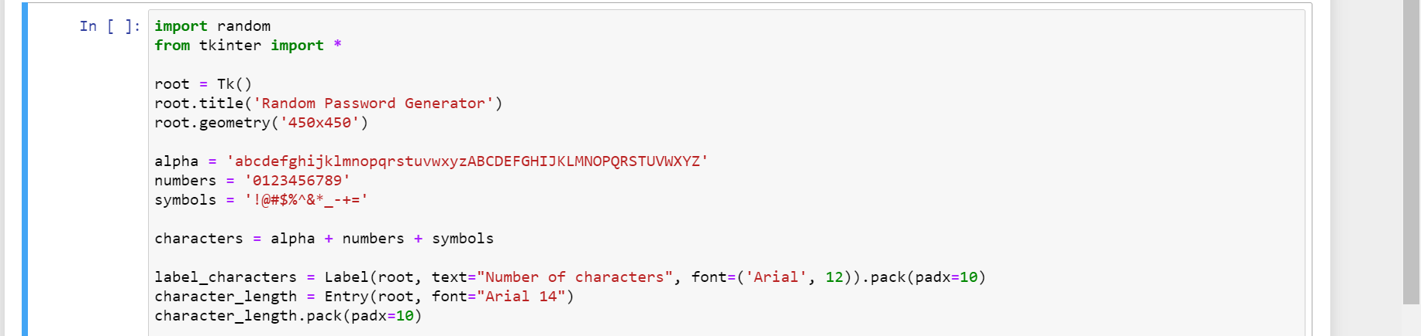
Technical aspects (source code)

Slide 6
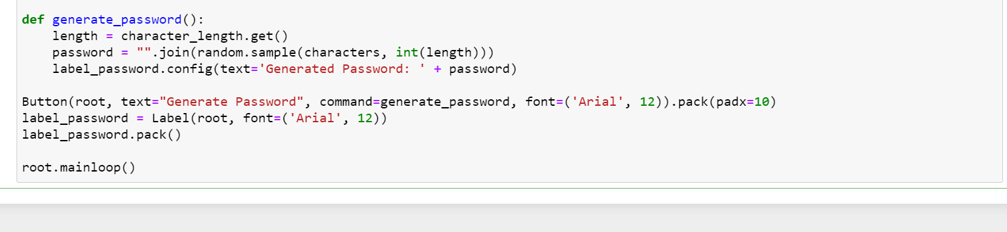




Technical aspects (source code)

Slide 7
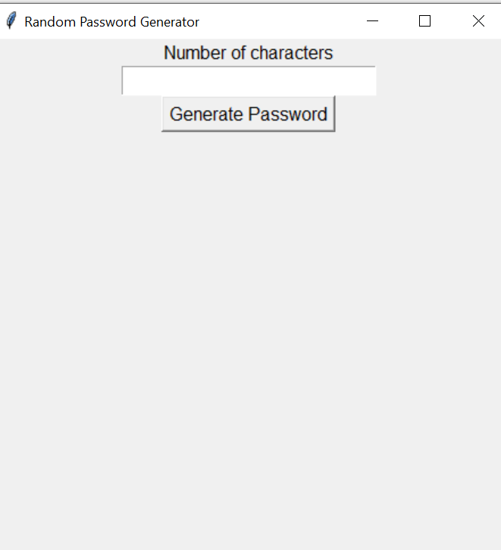
Front End of the Project (Flow process)
In the given box we will provide the no. of characters the password should be.
When we press GENERATE PASSWORD We will get random password of our desired no.

Slide 8
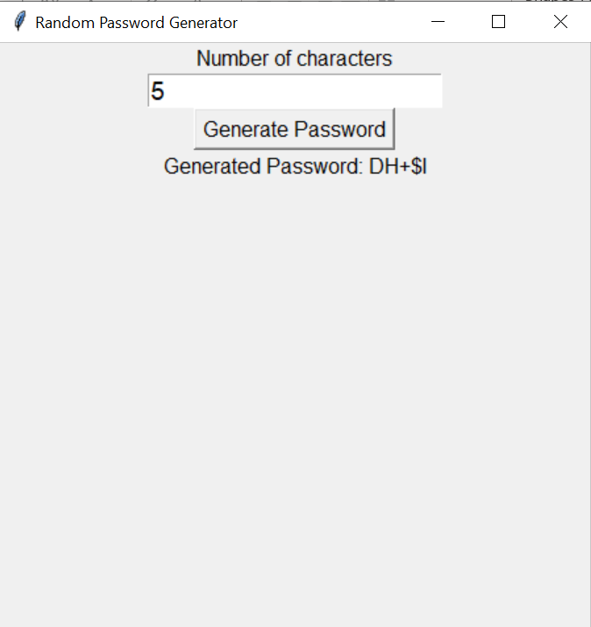
Front end of the project (outcome)
For e.g. We have entered 5 in the given box, Then we had got RANDOM PASSWORD of our desired no. i.e. DH+$I
Similarly , we can get more passwords of our desired value

Slide 9
Thank you

